Slide 1

PROGRAM STUDI INFORMATIKA
FAKULTAS TEKNIK DAN INFORMATIKA UNIVERSITAS MULTIMEDIA NUSANTARA
SEMESTER III TAHUN AJARAN GANJIL 2025/2026
IF350 – SOFTWARE ENGINEERING AND PROJECT MANAGEMENT
Minggu/Pertemuan ke 1 – Software Engineering&Project Methodologies
Eunike Endariahna Surbakti, S.Kom., M.T.I

Slide 2
Weekly Learning Outcomes of the Course (Sub-CLO)
Sub-CPMK 0311
Explain the definition and scope of software engineering and the role of project management (C2)
IF 350 – SOFTWARE ENGINEERING AND PROJECT MANAGEMENT – GASAL 2025/2026

Slide 3
Learning Objectives
Describe the software crisis and how the often dismal track record for information technology (IT) projects provides a motivation for changing how we view and manage IT projects.
Explain the socio-technical, project management and knowledge management approaches that support ITPM.
Define what an IT project is and describe its attributes.
Define the discipline called project management.
Describe the role and impact IT projects have on an organization.
Identify the different roles and interests of project stakeholders.
Describe the Software Engineering and project life cycle (PLC).
Describe the Systems Development Life Cycle ( SDLC).
Describe the Waterfall method for developing the project’s product or system.
Describe the Agile approach for developing the project’s product or system as well as two commonly used approaches called eXtreme Programming (XP) and Scrum.
Describe and apply the concept of Leaning Cycles and lessons learned.
IF 350 – SOFTWARE ENGINEERING AND PROJECT MANAGEMENT – GASAL 2025/2026

Slide 4
Introduction
Information Technology (IT) projects are organizational investments that require: Time Money Other resources such as people, technology, facilities, etc.
Organizations expect some type of value in return of this investment
IT Project Management is a relatively new discipline that combines traditional Project Management with Software Engineering/Management Information Systems to make IT projects more successful.
IF 350 – SOFTWARE ENGINEERING AND PROJECT MANAGEMENT – GASAL 2025/2026

Slide 5
An ITPM Approach
Organizational resources are limited, so organizations must choose among competing interests to fund specific projects.
This decision should be based on the value a competing project will provide to an organization.
IF 350 – SOFTWARE ENGINEERING AND PROJECT MANAGEMENT – GASAL 2025/2026

Slide 6
Which Situation is Worse?
Successfully building and implementing a system that provides little or no value to the organization.
OR
Failing to implement an information system that could have provided value to the organization, but was poorly developed or poorly managed.
IF 350 – SOFTWARE ENGINEERING AND PROJECT MANAGEMENT – GASAL 2025/2026

Slide 7
The Software Crisis
The CHAOS study published in 1995 by The Standish Group found that although the U.S spent over $250 billion on IT projects, approximately
31% were cancelled before completion
53% were completed but over budget, over schedule, and did not meet original specifications.
For mid-size companies, average cost overruns were 182%, while average schedule overruns were 202%!
IF 350 – SOFTWARE ENGINEERING AND PROJECT MANAGEMENT – GASAL 2025/2026

Slide 8
The Newest Software Crisis
According to a recent article titled “The AI Speed Trap: Why Software Quality Is Falling Behind in the Race to Release,” the following alarming trends characterize the current software delivery environment:
Two-thirds of businesses face a high risk of software outages in the coming year.
Nearly 50% of organizations report losses of over $1 million annually due to poor software quality.
This highlights a troubling trade-off:
the push for speed
especially through generative AI
has outpaced safeguards like proper testing, resulting in outages, security risks, and mounting technical debt
IF 350 – SOFTWARE ENGINEERING AND PROJECT MANAGEMENT – GASAL 2025/2026

Slide 9
Software Failures & Inefficiencies
The 2025 State of Software Engineering Excellence report, based on more than 650 engineering leaders, reveals critical bottlenecks in DevOps and developer workflows:
67% of teams cannot build and test their environments within 15 minutes.
64% still depend on manual steps for infrastructure code deployments.
61% report code reviews taking over a day.
55% lack quality gates in their build pipelines.
52% do not have essential incident management tools.
50% of application deployments are still manual.
These inefficiencies collectively result in millions lost annually due to wasted productivity, operational friction, and delayed innovation.
IF 350 – SOFTWARE ENGINEERING AND PROJECT MANAGEMENT – GASAL 2025/2026

Slide 10
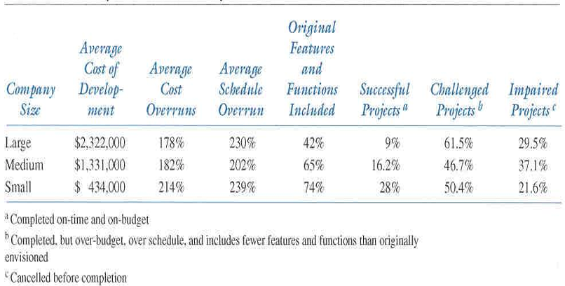
Summary of The CHAOS Study Results
IF 350 – SOFTWARE ENGINEERING AND PROJECT MANAGEMENT – GASAL 2025/2026

Slide 11
Why Do Projects Fail?
Larger projects have the lowest success rate and appear to be more risky than medium and smaller projects: Technology, business models and markets change so rapidly that a project that takes more than a year can be obsolete before they are completed.
The Chaos study also provides some insight as to the factors that influence project success.
IF 350 – SOFTWARE ENGINEERING AND PROJECT MANAGEMENT – GASAL 2025/2026

Slide 12
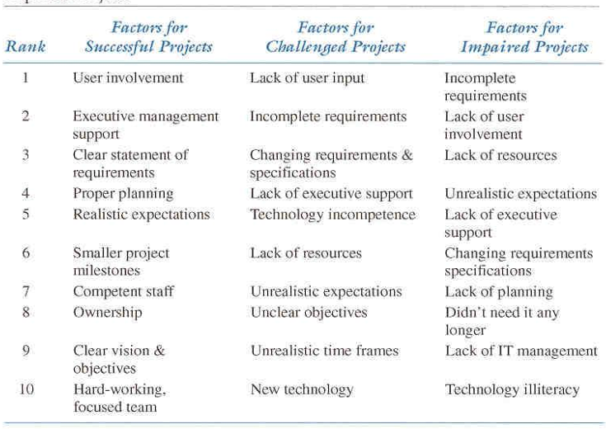
Summary of Factor Ranking for Successful, Challenged and Impaired Projects
IF 350 – SOFTWARE ENGINEERING AND PROJECT MANAGEMENT – GASAL 2025/2026

Slide 13
Has the Current State of IT Projects Changed Since 1995?
The Standish Group has continued to study IT projects over the years.
In general, IT Projects are showing higher success rates due to
Better project management tools & processes
Smaller projects
Improved communication among stakeholders
More skillful IT project managers
But there is still ample opportunity for improvement!
IF 350 – SOFTWARE ENGINEERING AND PROJECT MANAGEMENT – GASAL 2025/2026

Slide 14
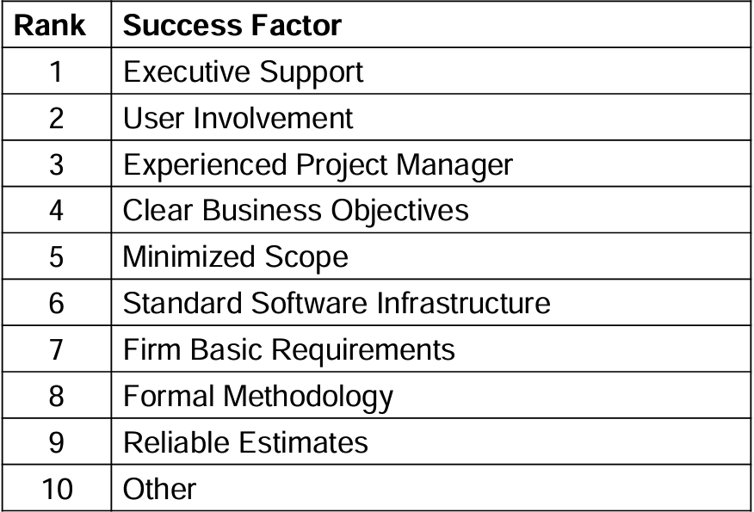
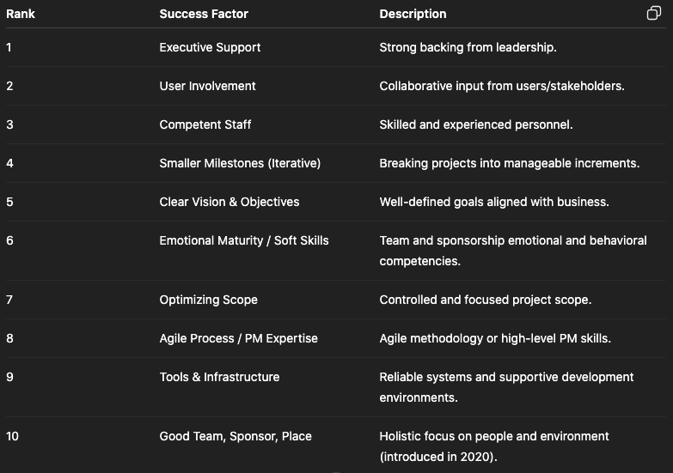
New Top Ten Factors for IT Project Success Source: Extreme Chaos. The Standish Group International, Inc. 2001. http://www.standishgroup.com/sample_research/index.php Vs 2020
IF 350 – SOFTWARE ENGINEERING AND PROJECT MANAGEMENT – GASAL 2025/2026

Slide 15
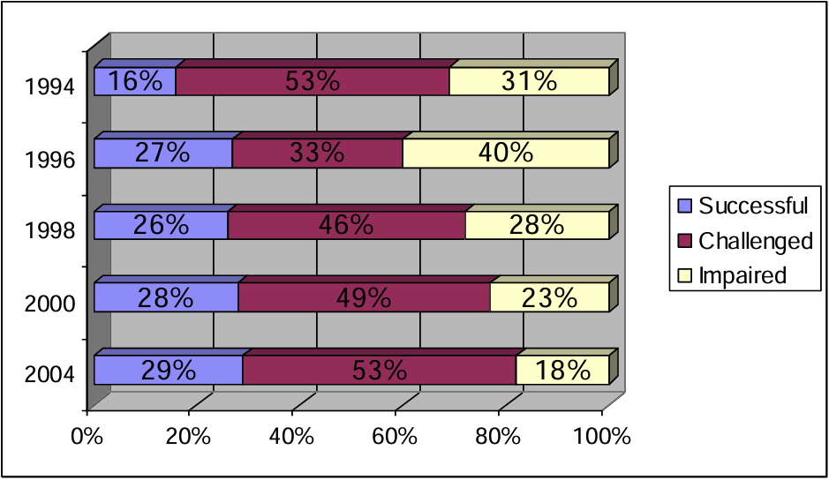
Summary of Chaos Studies
IF 350 – SOFTWARE ENGINEERING AND PROJECT MANAGEMENT – GASAL 2025/2026

Slide 16
Improving the likelihood of Success
Socio-technical Approach
Project Management Approach
processes and infrastructure (Methodology)
Resources
Expectations
Competition
efficiency and effectiveness
Project Management Approach
Knowledge Management Approach
lessons learned
best practices
shared knowledge
IF 350 – SOFTWARE ENGINEERING AND PROJECT MANAGEMENT – GASAL 2025/2026

Slide 17
Project Management
Definitions:
A project is a temporary endeavor undertaken to accomplish a unique purpose.
Project management is the application of knowledge, skills, tools, and techniques to project activities in order to meet or exceed project requirements
IF 350 – SOFTWARE ENGINEERING AND PROJECT MANAGEMENT – GASAL 2025/2026

Slide 18
Project Attributes
Time Frame
Purpose (to provide value!)
Ownership
Resources (the triple constraint)
Roles
Project Manager
Project Sponsor
SME (domain & technical)
Risk & Assumptions
Purpose (to provide value!)
Ownership
Interdependent Tasks
Planned Organizational Change
Operate in Environments Larger than the Project Itself
IF 350 – SOFTWARE ENGINEERING AND PROJECT MANAGEMENT – GASAL 2025/2026

Slide 19
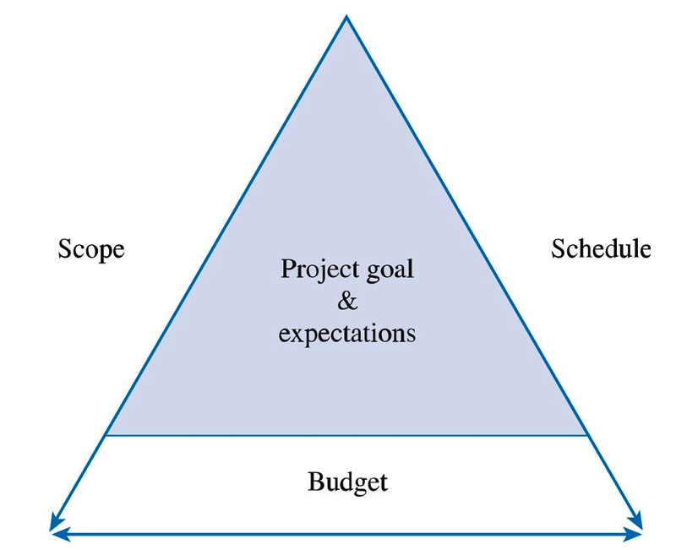
The Triple Constraint
IF 350 – SOFTWARE ENGINEERING AND PROJECT MANAGEMENT – GASAL 2025/2026

Slide 20
The Project Life Cycle and IT Development
Project Life Cycle (PLC)
A collection of logical stages or phases that maps the life of a project from its beginning to its end in order to define, build and deliver the product of the project i.e., the information system
Projects are divided into phases to increase manageability and reduce risk
Phase exits, stage gates, or kill points are decision points at the end of each phase to evaluate performance, correct problems or cancel the project
Fast tracking is the overlapping of phases to reduce the project’s schedule, can be risky!
IF 350 – SOFTWARE ENGINEERING AND PROJECT MANAGEMENT – GASAL 2025/2026

Slide 21
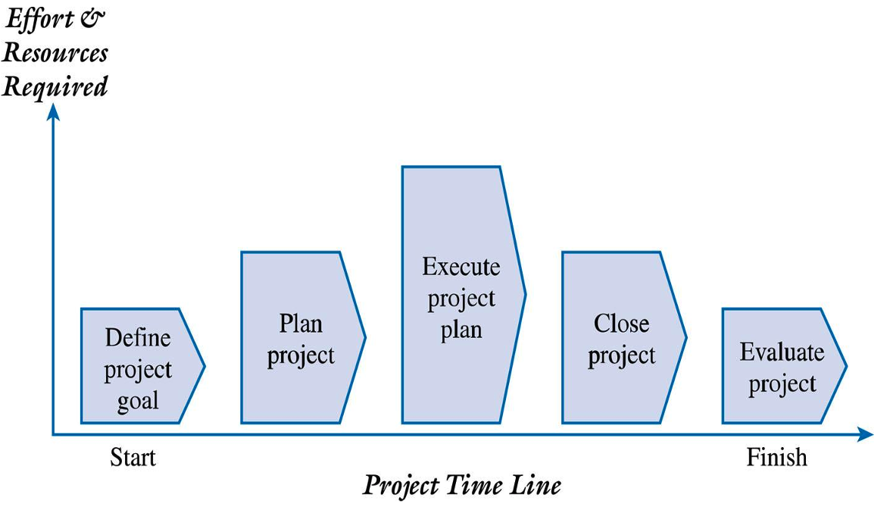
Generic Project Life Cycle
IF 350 – SOFTWARE ENGINEERING AND PROJECT MANAGEMENT – GASAL 2025/2026

Slide 22
Systems Development Life Cycle (SDLC)
Represents the sequential phases or stages an information system follows throughout its useful life
Useful for understanding the development of the project’s largest work product – the application system
Phases/Stages
Planning
Analysis
Design
Implementation
Maintenance and Support
IF 350 – SOFTWARE ENGINEERING AND PROJECT MANAGEMENT – GASAL 2025/2026

Slide 23
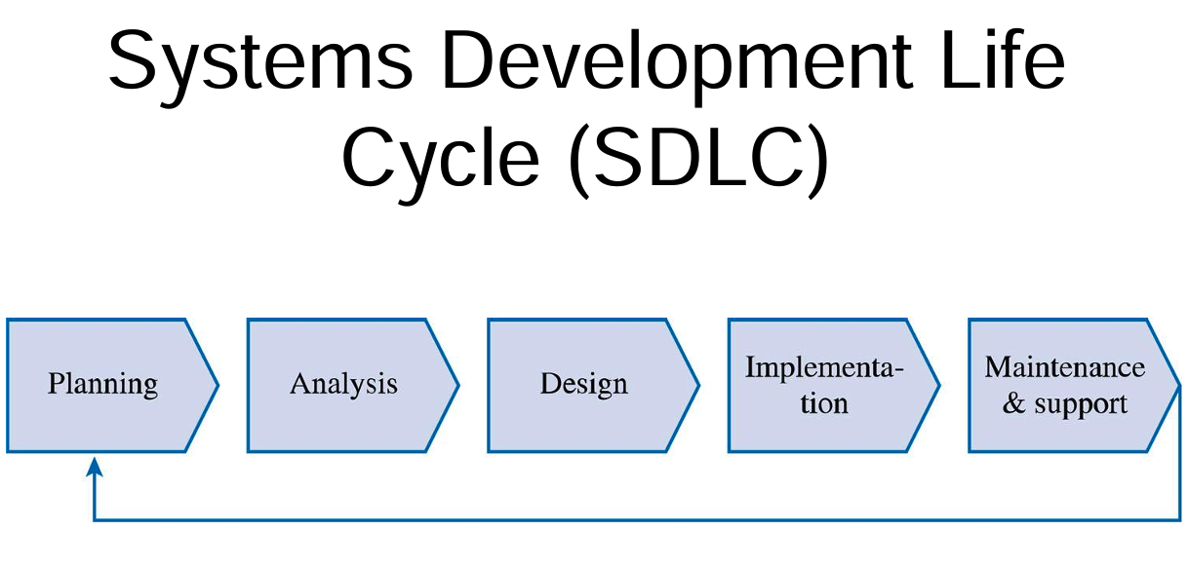
Systems Development Life Cycle (SDLC)
IF 350 – SOFTWARE ENGINEERING AND PROJECT MANAGEMENT – GASAL 2025/2026

Slide 24
The Relationship Between the PLC annd the SDLC
The systems development life cycle (SDLC) becomes part of the project life cycle (PLC).
The PLC focuses on the project management phases, processes, tools and techniques for effectively managing the project.
The SDLC focuses on the software engineering phases, processes, tools and techniques for building and/or implementing the IT solution.
IF 350 – SOFTWARE ENGINEERING AND PROJECT MANAGEMENT – GASAL 2025/2026

Slide 25
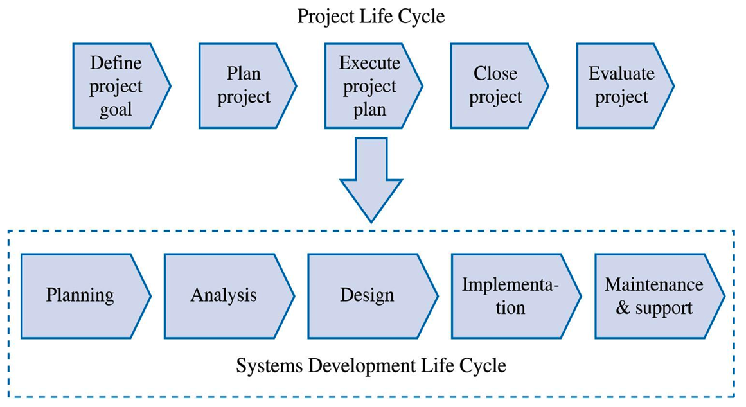
The Relationship Between the PLC annd the SDLC
IF 350 – SOFTWARE ENGINEERING AND PROJECT MANAGEMENT – GASAL 2025/2026

Slide 26
Putting the SDLC into Practice
Structured Approach to Systems Development
Waterfall Method
Rapid Applications Development (RAD)
Prototyping
Spiral Development
Extreme Programming
IF 350 – SOFTWARE ENGINEERING AND PROJECT MANAGEMENT – GASAL 2025/2026

Slide 27
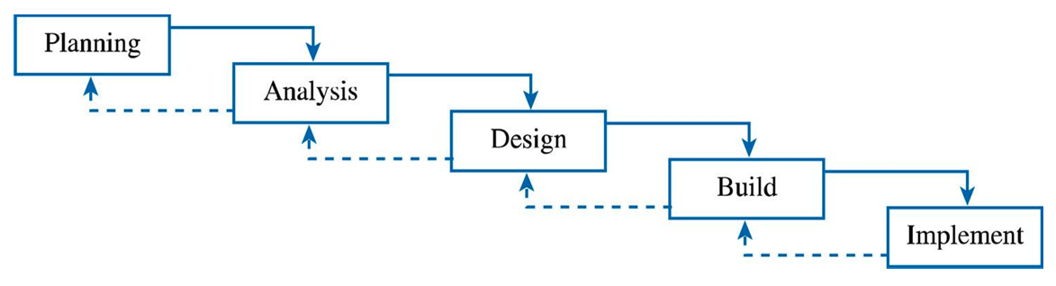
Structured Approaches Waterfall Method
IF 350 – SOFTWARE ENGINEERING AND PROJECT MANAGEMENT – GASAL 2025/2026

Slide 28
Extreme Project Management (XPM)
A new approach and philosophy to project management that is becoming increasingly popular.
Characterizes many of today’s projects that exemplify speed, uncertainty, changing requirements and high risks.
Traditional project management often takes an orderly approach while XPM embraces the fact that projects are often chaotic and unpredictable.
XPM focuses on flexibility, adaptability and innovation
Traditional and new approaches together can provide us with a better understanding of how to improve the likelihood of project success.
IF 350 – SOFTWARE ENGINEERING AND PROJECT MANAGEMENT – GASAL 2025/2026

Slide 29
Reference
Pressman, R. S., & Maxim, B. R. 2020. Software Engineering: A Practitioner’s Approach.
9th edition (International Edition). New York: McGraw-Hill Education.
Marchewka, J. T. 2015. Information Technology Project Management: Providing Measurable Organizational Value.
5th edition. Hoboken, New Jersey: John Wiley & Sons, Inc.
Sommerville, I. 2016. Software Engineering. 10th edition. Harlow, England: Pearson Higher Education.
Project Management Institute. 2021. A Guide to the Project Management Body of Knowledge (PMBOK® Guide). 7th edition. Newtown Square, Pennsylvania: Project Management Institute, Inc.
IF 350 – SOFTWARE ENGINEERING AND PROJECT MANAGEMENT – GASAL 2025/2026

